Slide 1



A model-based filter to improve local differential privacy
Miguel Gutierrez¹, Valérie Gauthier², Juan F. Pérez²
¹MercadoLibre, Colombia ²Universidad de los Andes, Colombia
Notes:
10. Joint work with.

Slide 2

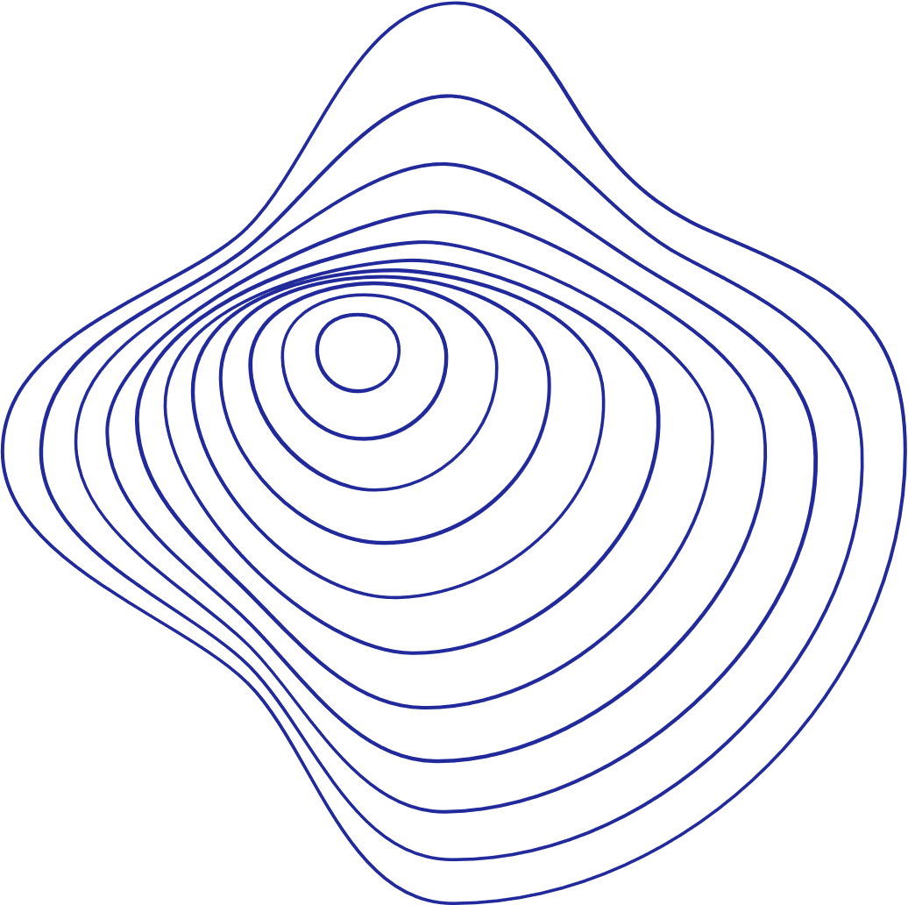
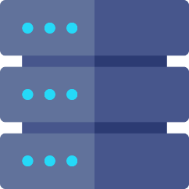

Introducción Privacidad Diferencial
Notes:
* Explicar Diferencial.

Slide 3
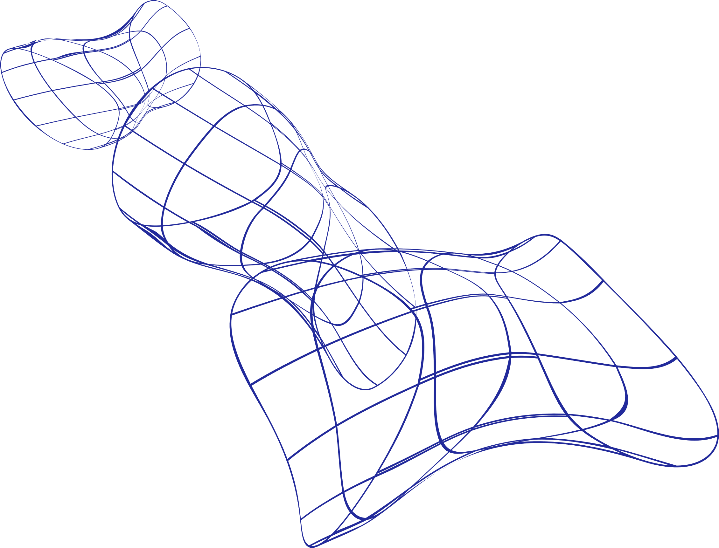
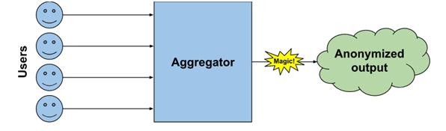
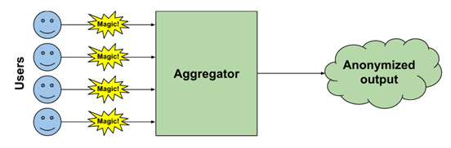
Tipos de privacidad diferencial
Privacidad Diferencial Global
Privacidad Diferencial Local
Notes:
Negamiento.
Confianza centralizado.
Repudio información individual.

Slide 4


Privacidad diferencial local
Client
1
0
0
+
=
1
0
1
Web 1
Server
Client
0
0
1
+
=
1
1
0
Web 2
Notes:
30. The problem is that we want to collect data that people may not be willing/liking to share it until up to a degree. Local Differential Privacy , tries to solve this problem by adding noise to a representation of the data user’s values. The addition of noise allows the user to deny any responsibility and protect its privacy. 1,0,0 -> 1,0,1

Slide 5
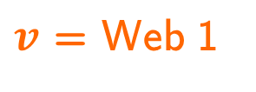
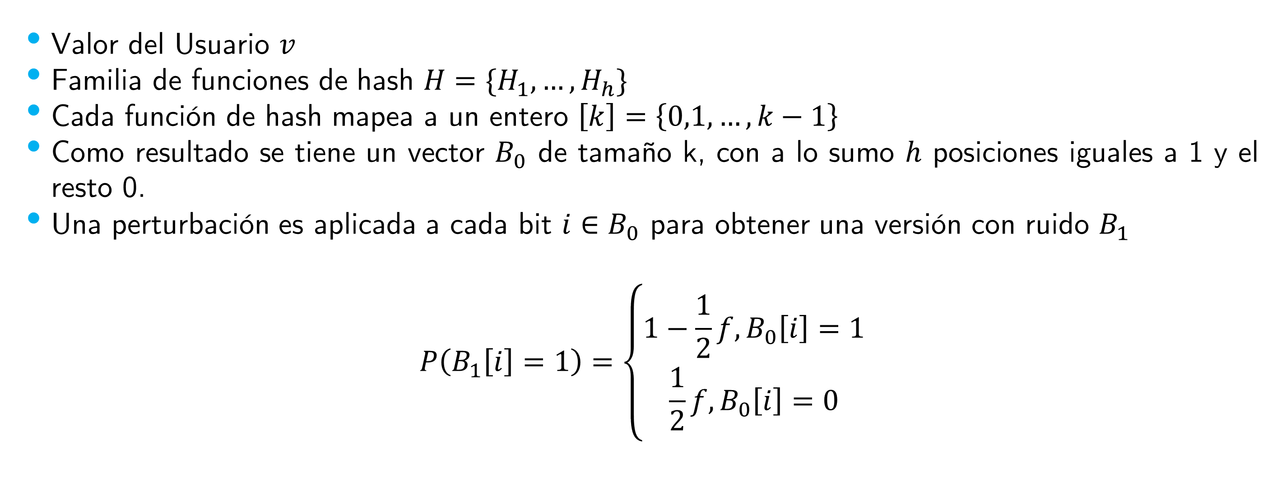


RAPPOR (Primer algoritmo LDP)
Configuración
Valor del Usuario $v$
Familia de funciones de hash ${H=\{H}_{1},…, H_{h}\}$
Cada función de hash mapea a un entero $\left[k\right]=\left\{0,1,…,k−1\right\}$
Como resultado se tiene un vector $B_{0}$ de tamaño k, con a lo sumo $h$ posiciones iguales a 1 y el resto 0.
Una perturbación es aplicada a cada bit $i∈B_{0}$ para obtener una versión con ruido $B_{1}$
$$P\left(B_{1}\left[i\right]=1\right)=\left\{\begin{aligned}1−\frac{1}{2}f, B_{0}\left[i\right]=1 \\ \frac{1}{2}f, B_{0}\left[i\right]=0\end{aligned}\right.$$
$$k=3$$
+
=
1
0
0
1
0
1
$$H_{1}\left(v\right)=0$$
$v$ = Web 1
Client
Notes:
30. The problem is that we want to collect data that people may not be willing/liking to share it until up to a degree. Local Differential Privacy , tries to solve this problem by adding noise to a representation of the data user’s values. The addition of noise allows the user to deny any responsibility and protect its privacy. 1,0,0 -> 1,0,1

Slide 6
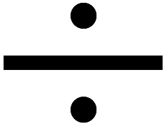

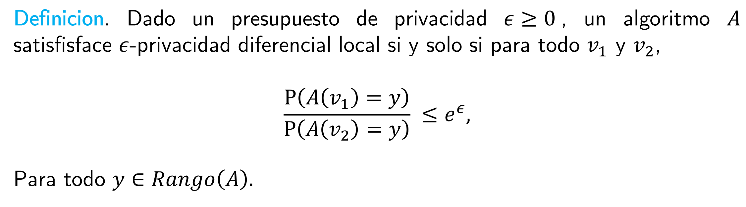

Privacidad Diferencial Local
Definicion. Dado un presupuesto de privacidad $ε≥0$, un algoritmo $A$ satisfisface $ε$-privacidad diferencial local si y solo si para todo $v_{1}$ y $v_{2}$,
$$\frac{P\left(A\left(v_{1}\right)=y\right)}{P\left(A\left(v_{2}\right)=y\right)} ≤e^{ε},$$
Para todo $y∈Rango\left(A\right).$
Client
1
0
0
+
=
1
1
0
Web 1
Server
$$\operatorname{Pr}\left(A\left(v_{1}\right)=y\right)$$
$$\operatorname{Pr}\left(A\left(v_{2}\right)=y\right)$$
0
0
1
+
=
1
1
0
Web 2
Notes:
What is local differential privacy ? Its a definition that set us an upper bound about the ratio of the probabilities that if I pass two differents values to the same algorithm I get the same output. 90

Slide 7
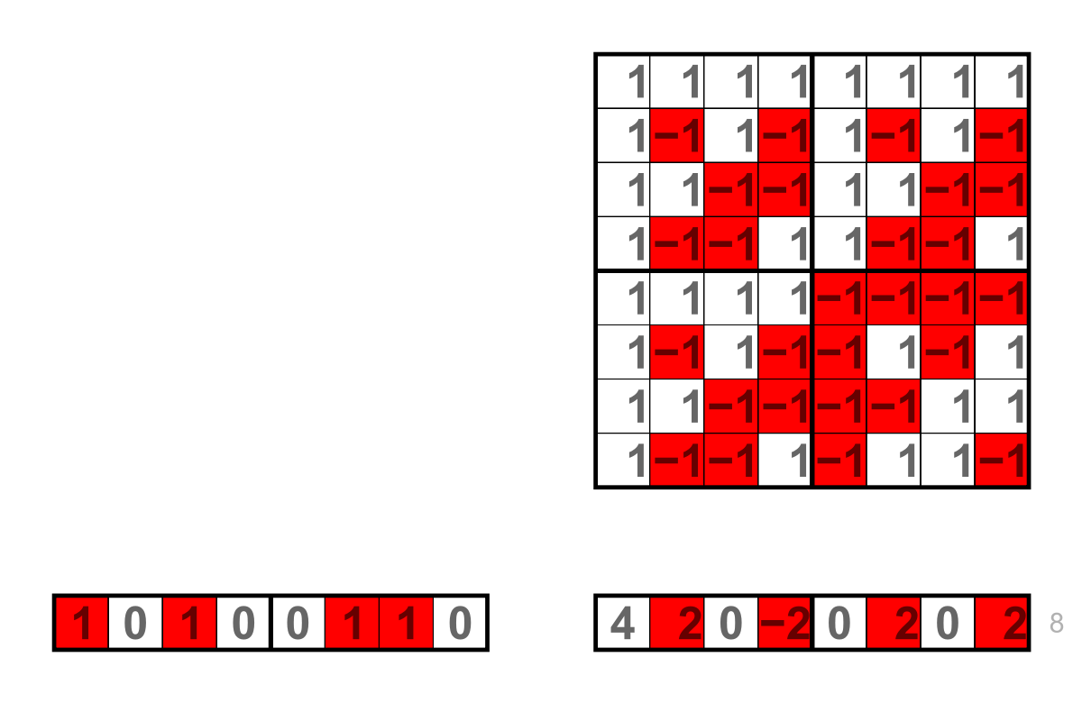
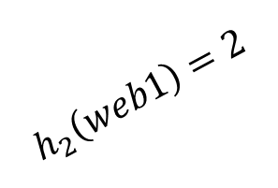

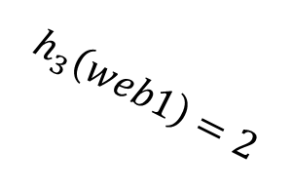
Estado del Arte
Local hashing o Transformada de Hadamard
Local Hashing
Hadamard transform
$$h_{2}\left(web1\right)=2$$
0
1
0
1
0
0
x
Web 1
$$h_{2}\left(web1\right)=1$$
$$h_{3}\left(web1\right)=2$$
0
1
0
1. Wikipedia. Retrieved July 11, 2022, from https://en.wikipedia.org/wiki/Hadamard_transform
2. Ilya Katsov. Probabilistic data structures for web analytics and data mining, Retrieve July 11,20022 from https://highlyscalable.wordpress.com/2012/05/01/probabilistic-structures-web-analytics-data-mining/
Notes:
30. Local hasing – collisions, Hadamard- reduce memory , Bloom filter –vector , Count Sketches - Matrix

Slide 8
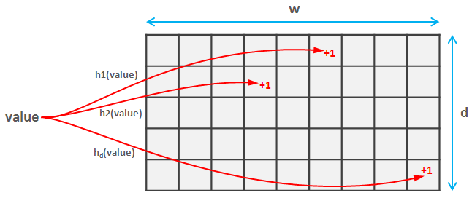



Estado del Arte
Reducción de dominio utilizando sketches o Bloom Filters
$$Filtro de Bloom$$
Count Sketch
$$h_{2}\left(web1\right)=2$$
1
0
1
Web 1
$$h_{2}\left(web1\right)=1$$
Notes:
What is local differential privacy ? Its a definition that set us an upper bound about the ratio of the probabilities that if I pass two differents values to the same algorithm I get the same output. 90

Slide 9
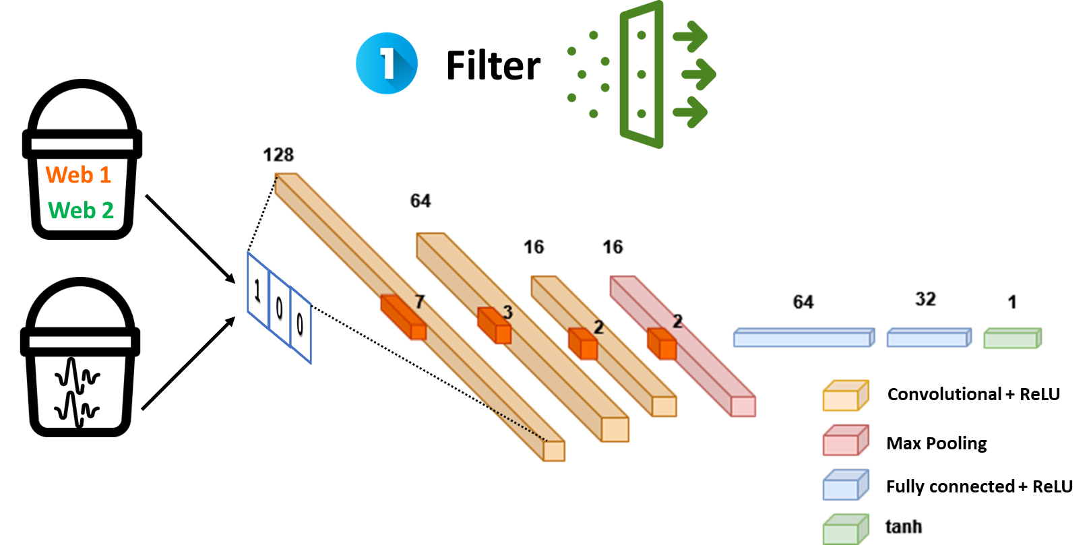
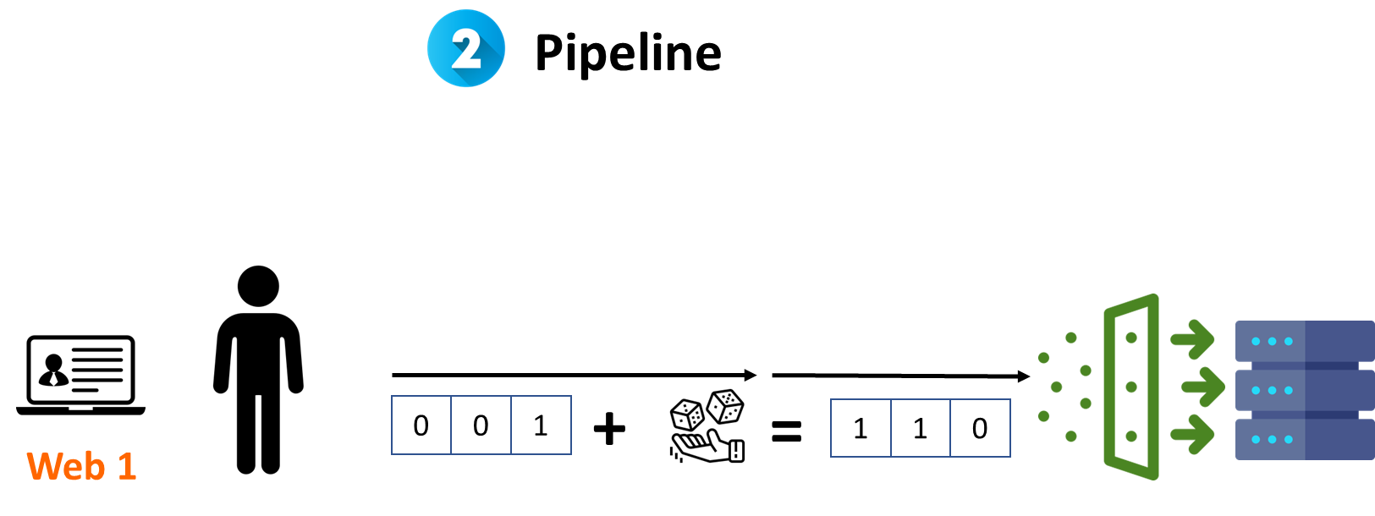


Solución
$$K$$
1: Ruidoso
Clasificador
$$U$$
0: No Ruidoso
Notes:
What we proposed is that because of the nature of the problem, the algorithm can sometimes add too much noise to some specific values, and when we try to estimate it, it harm the estimation process. Therefore, we propose to create a filter that removes excessively noisy observations at the server. The pre-filter thus faces a binary classification task. That is, we want to use a learning model f that can predict if an encoded value v is similar to any of the encoded versions of the expected values, or if instead it can be considered as a noisy observation. To this end we build two sets: the first set is K, which is made of all the size-k vectors that the Bloom filter generates for each of the values expected to be
observed. Note that these vectors are encoded in that they have passed through the Bloom filter, but no randomization noise has been added. The second set is U, which we build by generating random size-k vectors, where each bit is set
to one with probability γ. 90

Slide 10
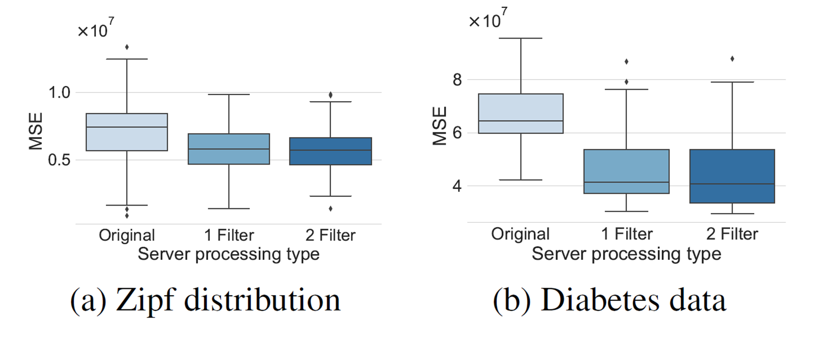
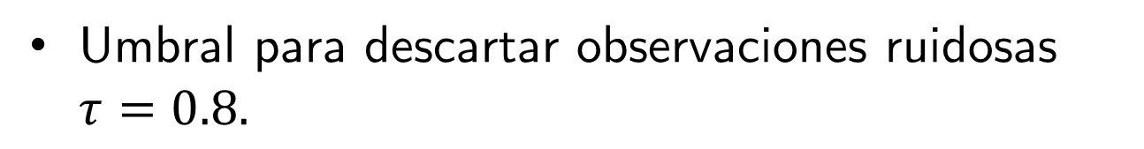
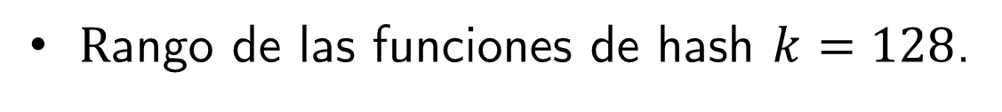
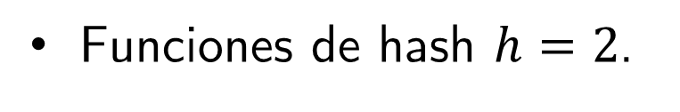
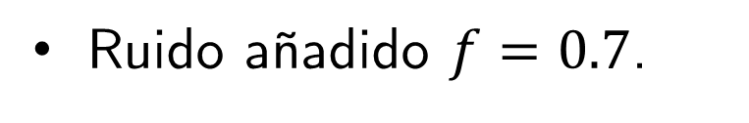
Resultados: Comparación de Rappor con 1 y 2 pre-filtros.
Funciones de hash $h=2$.
$R$ango de las funciones de hash $k=128$.
Umbral para descartar observaciones ruidosas $τ=0.8.$
Ruido añadido $f=0.7$.
Notes:
Hablar de las bases de datos.

Slide 11
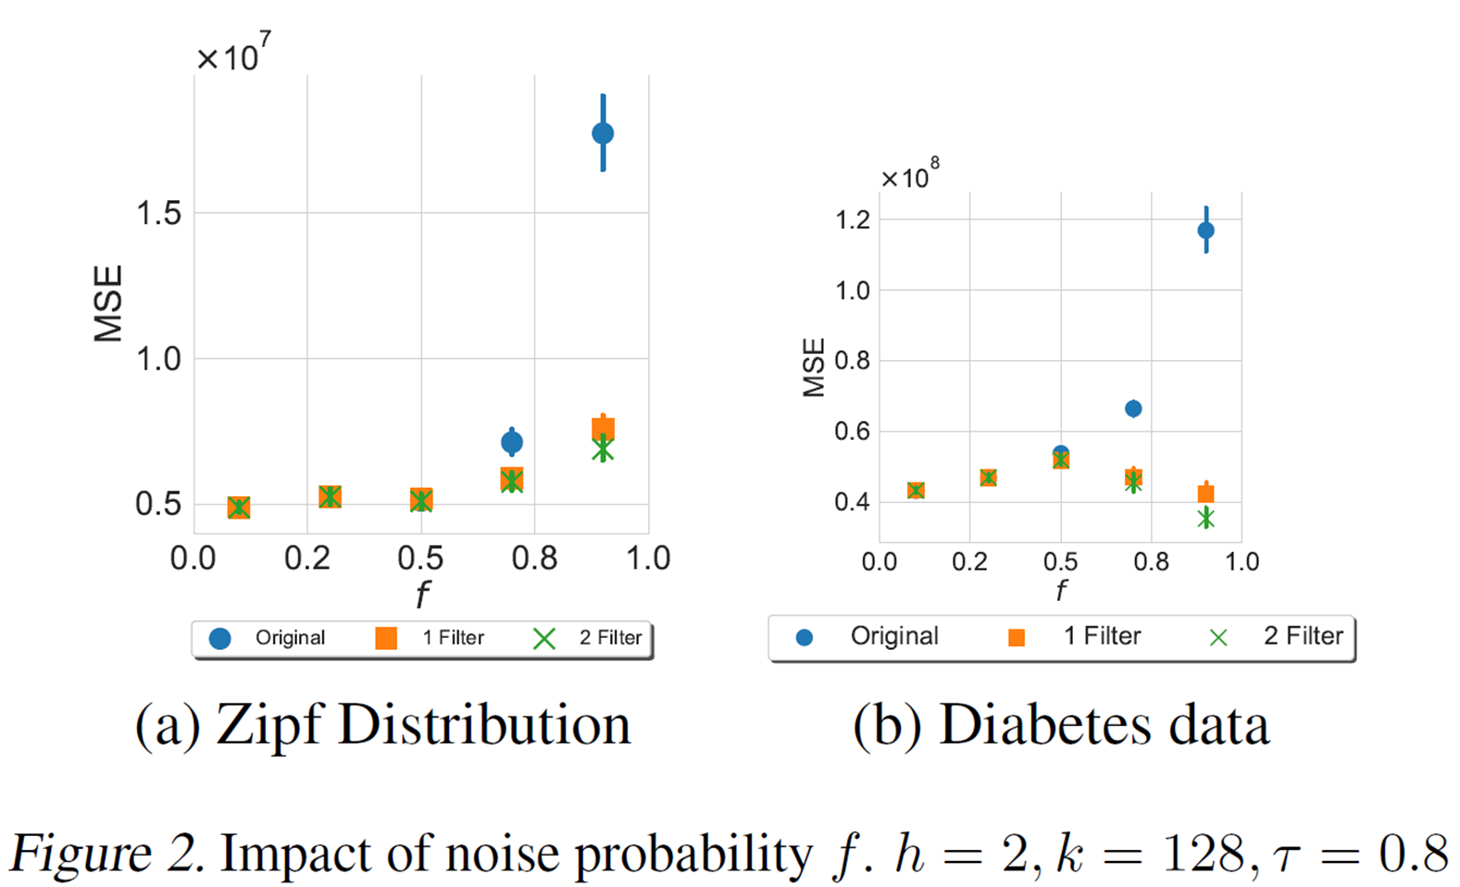
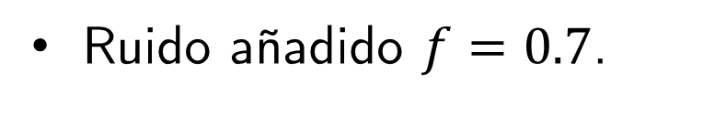
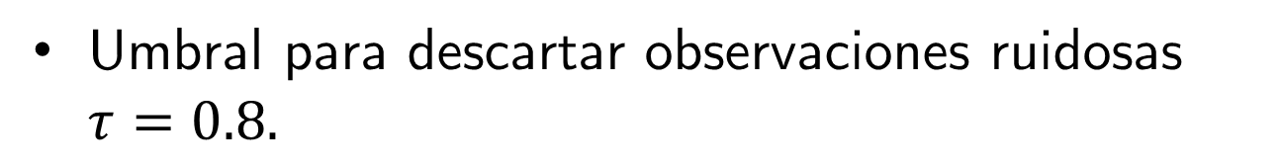
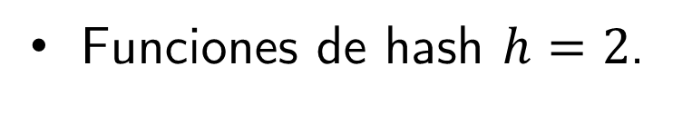
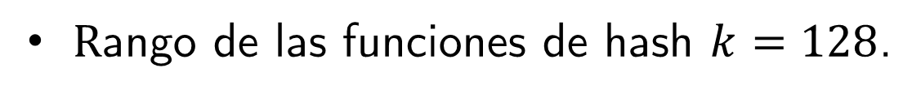
Resultados: Impacto de la probabilidad ruidosa f.
Funciones de hash $h=2$.
$R$ango de las funciones de hash $k=128$.
Umbral para descartar observaciones ruidosas $τ=0.8.$
Ruido añadido $f=0.7$.
Notes:
To assess the effectiveness of our approach, we evaluate first it on synthetic data generated from a Zipf distribution with a domain of size d = 100 and a system composed of n = 100000 users or observations. Each observation goes through the Bloom filter and randomized response steps of Rappor before being processed by the pre-filter. In Figure 1 we consider an initial setup with a privacy budget of ϵ = 3, a Bloom filter with h = 2, k = 128, and a threshold in the learning model of τ = 0.8. With this privacy budget, the associated value of f is 0.64. We consider four different setups: the original setup from Rappor (Erlingsson et al., 2014), the setup adding one filter, and adding a second filter. For the second filter we consider the description in Section 3.3 and a second version where we invert the indexes when applying the OR operator. 100 repetitions with different datasets and compare the mean squared error (MSE) of the frequency estimation. Figure 1(a) shows that adding the pre-filter model results in a better estimation, reflected in a smaller MSE mean and standard deviation. The introduction of a single filter reduces the mean MSE by about 24%, whereas including a second filter produces an additional, albeit smaller, reduction of 3%, for a total reduction in mean MSE of 27%. IN the second figure We now evaluate the impact of the probability f, which is fixed by the privacy budget (a tighter budget requires a larger f) and determines how much noise is added to the output of the Bloom filter. The results in Figure 2(a) show that as more noise is added through the probability f the gap between the baseline RAPPOR and pre-filter model increases. This means the model-based pre-filter is able to drop those observations which are excessively noisy and improves the count estimation.60

Slide 12
Discusión
Los beneficios son extraídos mas que todo solo con un pre-filtro.
La adición del segundo pre-filtro mejora los resultados, llevando la reducción en MSE hasta un 31%.
Los beneficios son mayores cuando el ruido f es mas grande: presupuestos menores.
Trabajo Futuro: Ver el impacto de los parámetros h, k, y umbral τ.
El método propuesto funciona muy bien para valores moderados del tamaño de dominio.
Métodos alternativos son necesarios para tamaños de dominios grandes.
Notes:
Moderated: Change of thousands.90

Slide 13
Wrap up
Propuesta: Añadir un pre-filtro para descartar observaciones altamente ruidosas.
El pre-filtro mejora el paso de estimación.
El pre-filtro se basa en un modelo de aprendizaje profundo.
La adición del segundo pre-filtro mejora los resultados, llevando la reducción en MSE hasta un 31%.
Los beneficios son mayores cuando el ruido f es mas grande: presupuestos menores.
Gracias
Notes:
60. Its is possible to add a new filter base on a neural network and is very promising and we obtain very good reductions. It is relevant when the budget is greater. Es un primer paso.

